Slide 1
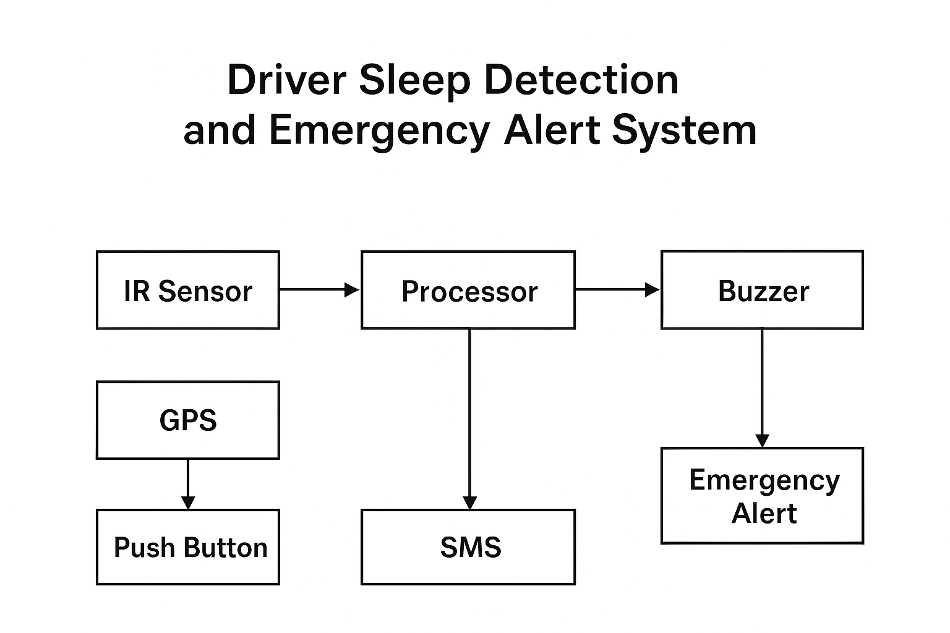
Driver Sleep Detection & Emergency Alert System
Paper Presentation - Slide Deck
An IoT-based Driver Sleep Detection & Emergency Alert System using ESP8266, IR sensors, GPS, and SIM800L GSM module. The system monitors driver motion, triggers local alarms, and sends SMS/call alerts with live location to emergency contacts, thereby preventing accidents caused by fatigue.
Block Diagram:

Slide 2
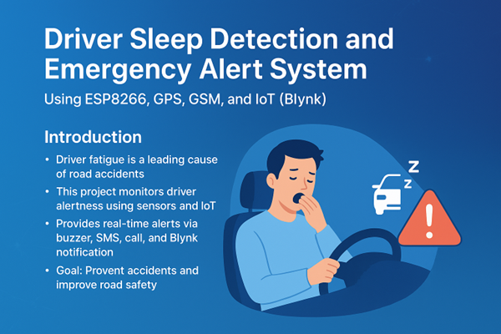
Introduction & Problem
Drowsy driving is a major cause of accidents. Traditional safety measures fail to prevent fatigue-related crashes. Real-time IoT-based monitoring is required. This project integrates sensors + GSM + GPS for active safety.

Slide 3
System Components & Block Diagram
ESP8266 NodeMCU (Wi-Fi microcontroller). IR Motion Sensor (driver motion detection). GPS Neo-6M (real-time tracking). SIM800L GSM/GPRS Module (SMS + call). Buzzer & LED (local alerts). Emergency Push Button (manual alerts).
IR Sensor → NodeMCU → Buzzer/LED. NodeMCU → GPS (location data). NodeMCU → SIM800L (SMS & calls). Emergency Button → Direct alert trigger. This ensures continuous monitoring & emergency response.

Slide 4
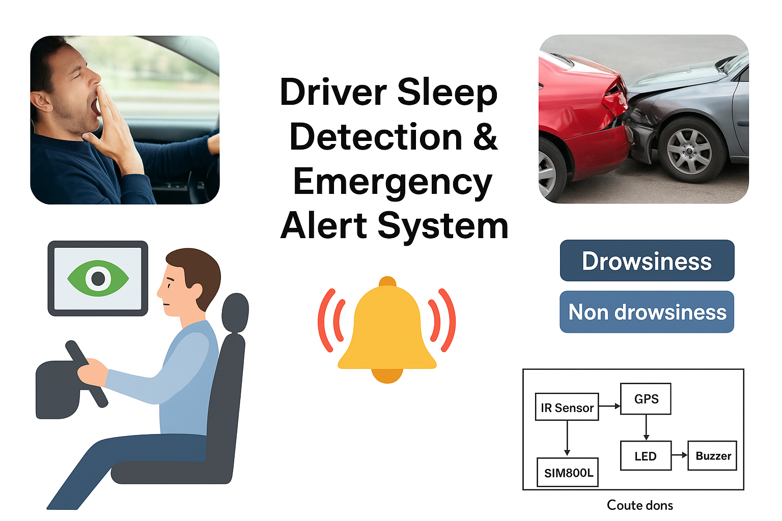
Working & Alerts
1. IR sensor checks driver activity. 2. No movement > 10 sec → Buzzer + LED alert. 3. If driver still inactive → SMS + Call with GPS location. 4. Emergency button can override & send immediate alert. 5. Alerts are also logged via Blynk IoT platform.

Slide 5
Advantages & Use Cases
Advantages: - Real-time monitoring. - Multi-channel alert system. - Low-cost, scalable IoT solution. - Easy to install and use. Use Cases: - Long-distance truck & bus drivers. - Taxi drivers during night shifts. - Personal car safety on long trips.

Slide 6
Future Scope & Conclusion
Future Scope: - AI-based facial recognition for drowsiness. - ECU integration for auto-speed control. - Cloud data logging for analytics. - Wearable integration for health monitoring. Conclusion: The Driver Sleep Detection System is a reliable IoT solution that detects fatigue, triggers alarms, and communicates emergencies in real-time, contributing to safer roads and accident prevention.

